Slide 1


SOLANA FRONTIER HACKATHON
HumanPulse Protocol
Privacy-first Proof of Unique Humanity infrastructure for Solana.
HumanPulse proves the presence of a unique living human at a specific moment in time — instantly, privately, and on-chain.
MVP focus: Sybil resistance for DAOs, airdrops, and token launches
Current implementation: webcam-based liveness, challenge-response, Solana Devnet token, and Anchor burn-on-use
Positioning: protocol-grade uniqueness layer, not a centralized KYC provider
Hackathon MVP • Solana Devnet
Source: HumanPulse Technical Whitepaper v7.2 and current MVP implementation.

Slide 2
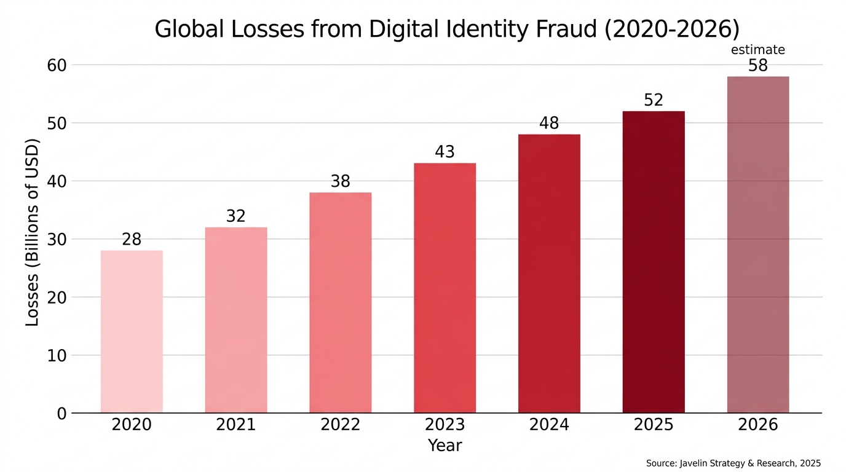
PROBLEM
The internet cannot tell humans from machines
This creates a growing attack surface for airdrops, DAO governance, token launches, and identity-sensitive consumer flows.
$52B
digital identity fraud losses in 2025
800K+
Sybil wallets identified in one large airdrop event
Today
CAPTCHAs, passwords, and weak liveness are breaking down
Centralized identity
Introduces custody, friction, and privacy risk.
Weak anti-bot tools
Generic CAPTCHAs and static checks are increasingly bypassable.
Missing primitive
Crypto lacks a neutral, privacy-aware proof of human presence.
What HumanPulse is designed to do
Significantly increase the cost of Sybil attacks while minimizing the amount of personal data required.
Source: HumanPulse Technical Whitepaper v7.2 and current MVP implementation.

Slide 3
SOLUTION
What HumanPulse proves in one verification
The protocol combines live presence checks, an unpredictable challenge, and on-chain proof consumption in a low-friction flow.
1. Live human
Webcam-based liveness checks that a live person is present now.
2. Challenge
The user responds to a real-time unpredictable prompt.
3. Proof consumed
The result is turned into a proof interaction that can be consumed on-chain.
4. Use on Solana
An application gates access, voting, or eligibility using the proof.
No biometric database
HumanPulse is intended to avoid storing raw biometric data on-chain or creating a centralized biometric vault.
Privacy-first UX
The complexity of proof generation is hidden from the user; the goal is fast verification with minimal disclosure.
Built for crypto use cases
Primary MVP use cases are DAO voting, airdrop eligibility, anti-bot gating, and token launch protection.
Source: HumanPulse Technical Whitepaper v7.2 and current MVP implementation.

Slide 4
CURRENT MVP
What we built for the hackathon
The current implementation demonstrates a practical HumanPulse flow on Solana Devnet. It is an MVP, not a fully production-hardened identity network.
Webcam-based liveness
Current MVP verification begins with live webcam input.
Challenge-response
An unpredictable prompt raises the attack cost for spoofing.
Solana Devnet $HPP token
Devnet token used inside the current proof consumption flow.
Scope discipline for judges
Current MVP / hackathon implementation: • Sybil resistance for DAOs, airdrops, and token launches • Webcam-based liveness and challenge-response • Live Solana Devnet proof-consumption transaction • Devnet $HPP token and Anchor burn-on-use program Technical roadmap and optional research modules are not represented as fully implemented.
Anchor burn-on-use program
On-chain burn logic demonstrates consumption of a verification primitive.
Live demo / widget
Challenge-response flow plus real Solana Devnet proof-consumption transaction.
Public artifacts
Technical whitepaper, demo video, figures, and pitch deck.
Hackathon deliverable
A working demonstration of proof-of-human gating on Solana Devnet, including a live proof-consumption transaction, demo site, video, repository, and whitepaper.
Source: HumanPulse Technical Whitepaper v7.2 and current MVP implementation.

Slide 5
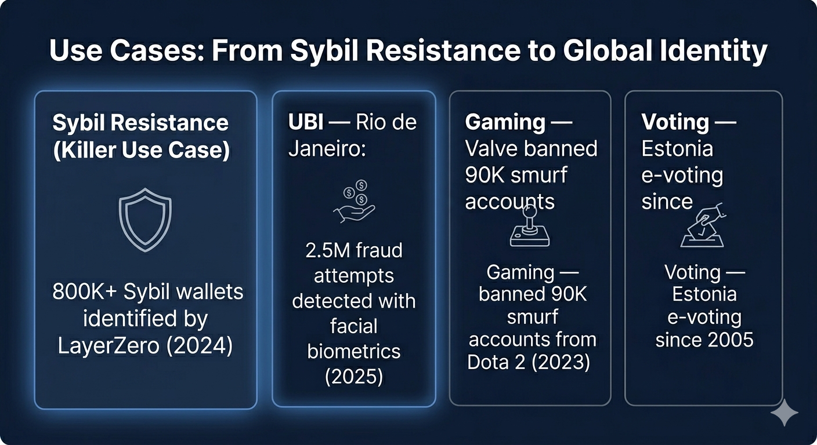
USE CASES
Start with the highest-urgency wedge: Sybil resistance
HumanPulse begins where the pain is immediate: incentive-heavy systems where fake or duplicated participation distorts outcomes.
Initial wedge
DAO voting, airdrops, token launches, and anti-bot gating are the clearest near-term applications.
Why it matters
A uniqueness layer can reduce false participation, improve fairness, and make incentive programs harder to game.
Longer-term direction
If the primitive is strong enough, the same network can support broader identity-sensitive consumer and governance flows.
Source: HumanPulse Technical Whitepaper v7.2 and current MVP implementation.

Slide 6
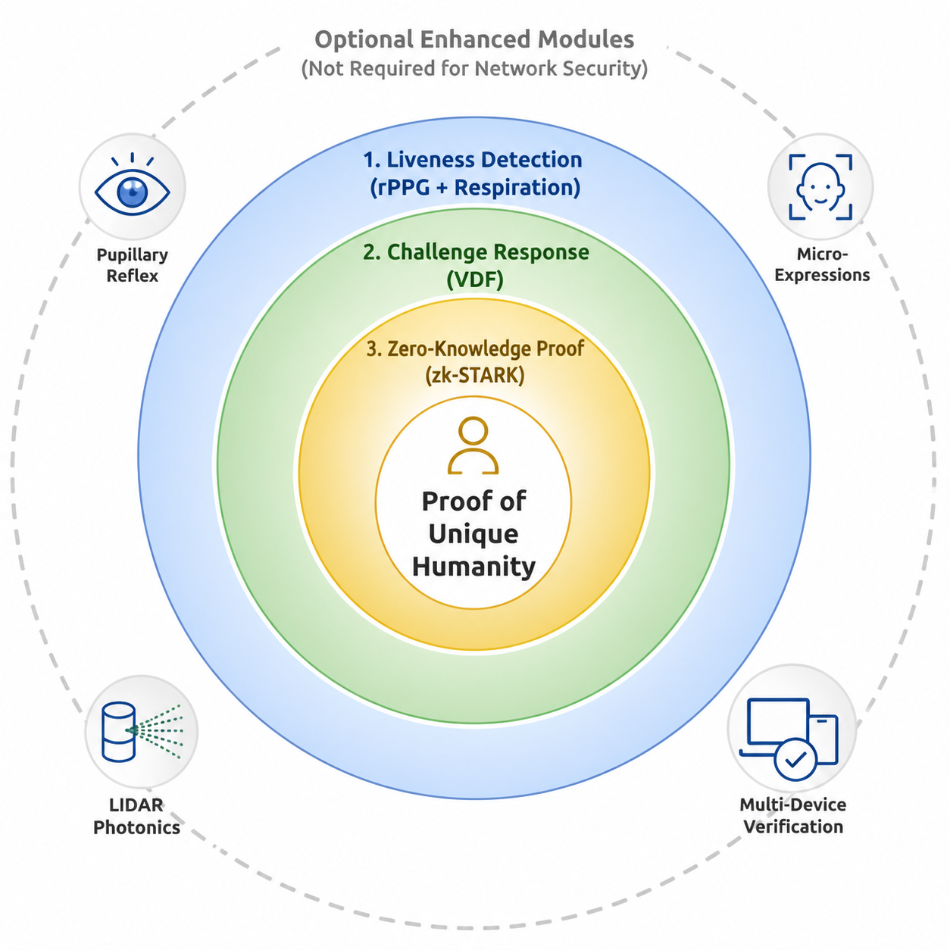
ARCHITECTURE
HumanPulse architecture: three layers, one claim
The protocol design combines liveness, challenge-response, and proof generation into a stacked uniqueness architecture.
1. Liveness detection
The protocol begins by measuring whether a live human is present. The MVP demonstrates webcam-based liveness; richer signal layers appear in the roadmap.
2. Challenge-response
A live challenge introduces unpredictability and makes replay or pre-rendered spoofing more difficult.
3. Proof layer
The whitepaper’s protocol direction culminates in zero-knowledge proof generation. The current MVP demonstrates the consumption side of the primitive on Solana Devnet.
Source: HumanPulse Technical Whitepaper v7.2 and current MVP implementation.

Slide 7
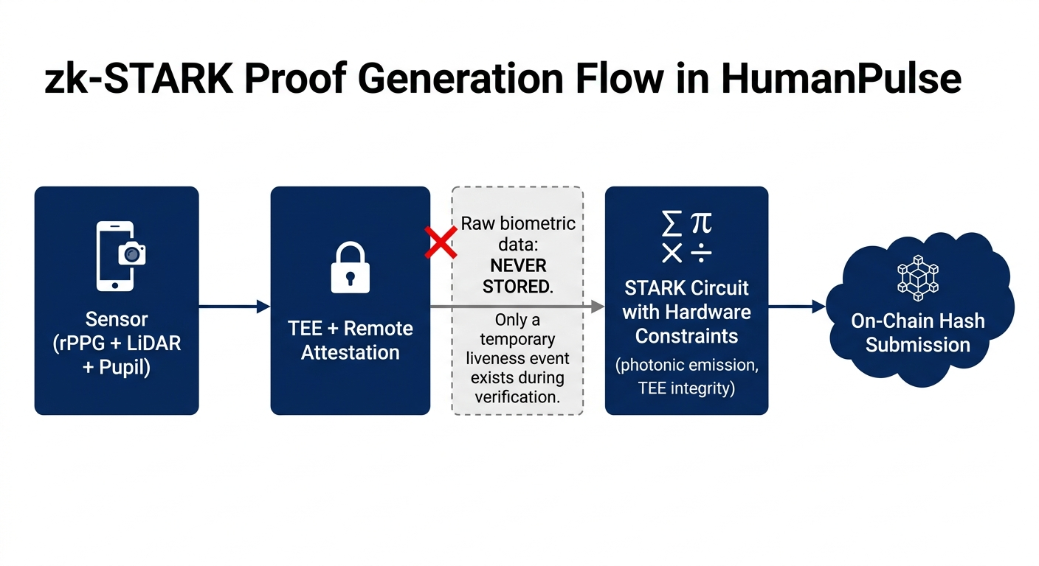
PRIVACY
Privacy is an architectural constraint
HumanPulse is intended to prove human presence without turning the protocol into a biometric data honeypot.
No raw biometrics on-chain
On-chain logic consumes proof outcomes, not raw face data.
Temporary processing
The protocol direction minimizes persistent exposure of sensitive inputs.
Proof, not identity disclosure
The target primitive is uniqueness verification, not full identity revelation.
Research roadmap
Recursive zk-STARK aggregation, TEEs, and local proof generation are roadmap modules.
Source: HumanPulse Technical Whitepaper v7.2. Research modules shown here are roadmap elements, not all current MVP features.

Slide 8
SOLANA INTEGRATION
Why Solana is the right execution layer
The current MVP uses Solana Devnet and an Anchor program to show how a uniqueness primitive can be consumed in a fast, low-cost on-chain flow.
Low-cost interactions
Frequent verification usage requires inexpensive on-chain actions.
Fast finality
Consumer-facing gating flows benefit from quick confirmation.
Programmable token logic
The burn-on-use pattern is implemented via an Anchor program on Devnet.
Composable applications
DAO voting, access control, launches, and rewards can all plug into the same primitive.
Developer fit
Anchor and Solana tooling make it practical to build an MVP quickly and clearly.
Current on-chain artifacts
Devnet program: D9tRQi8n...Q5B5N Devnet $HPP token: EsBZKfFm...ZSnR
MVP implementation
Current MVP: Solana Devnet proof-consumption transaction + Devnet $HPP token + Anchor burn-on-use program + demo website/widget. Roadmap: stronger proof aggregation, validator / aggregator architecture, and expanded privacy-preserving proof flows.
Source: HumanPulse Technical Whitepaper v7.2 and current MVP implementation.

Slide 9
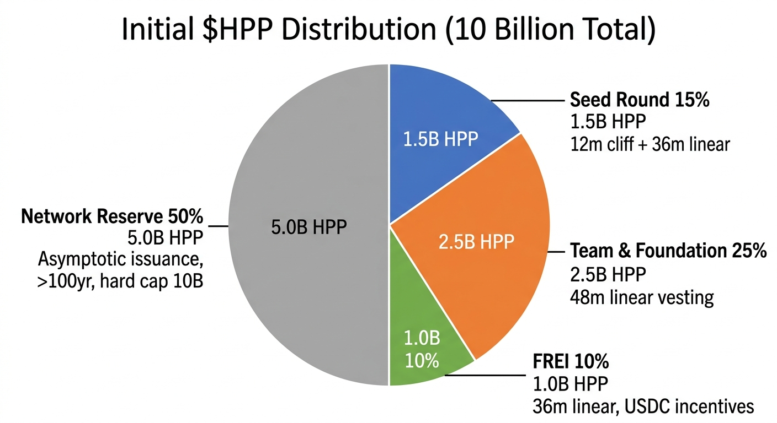
ON-CHAIN PRIMITIVE
A usage-driven $HPP economy
The whitepaper frames $HPP as a network primitive tied to proof usage. The current MVP demonstrates the burn-on-use concept on Solana Devnet.
Proof consumption
Verification is meant to be used, not merely held. Burn-on-use aligns token mechanics with activity.
MVP scope
The Devnet implementation demonstrates the mechanism; it is not presented as finalized production token economics.
Longer-term design
Broader token distribution, reserve structure, and network incentives follow governance and protocol maturation.
Source: HumanPulse Technical Whitepaper v7.2. Token structure shown is from the current protocol narrative and should be interpreted with roadmap context.

Slide 10
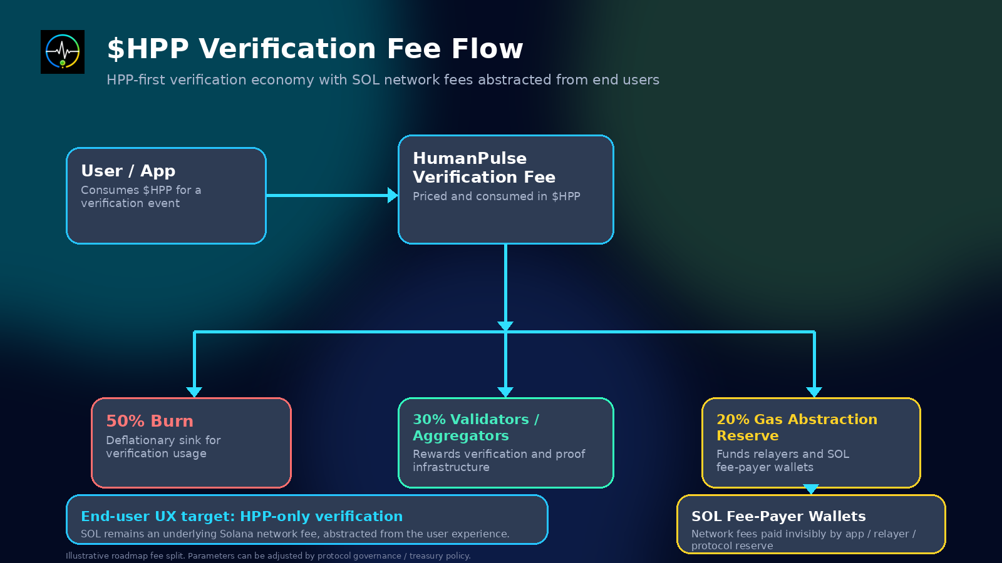
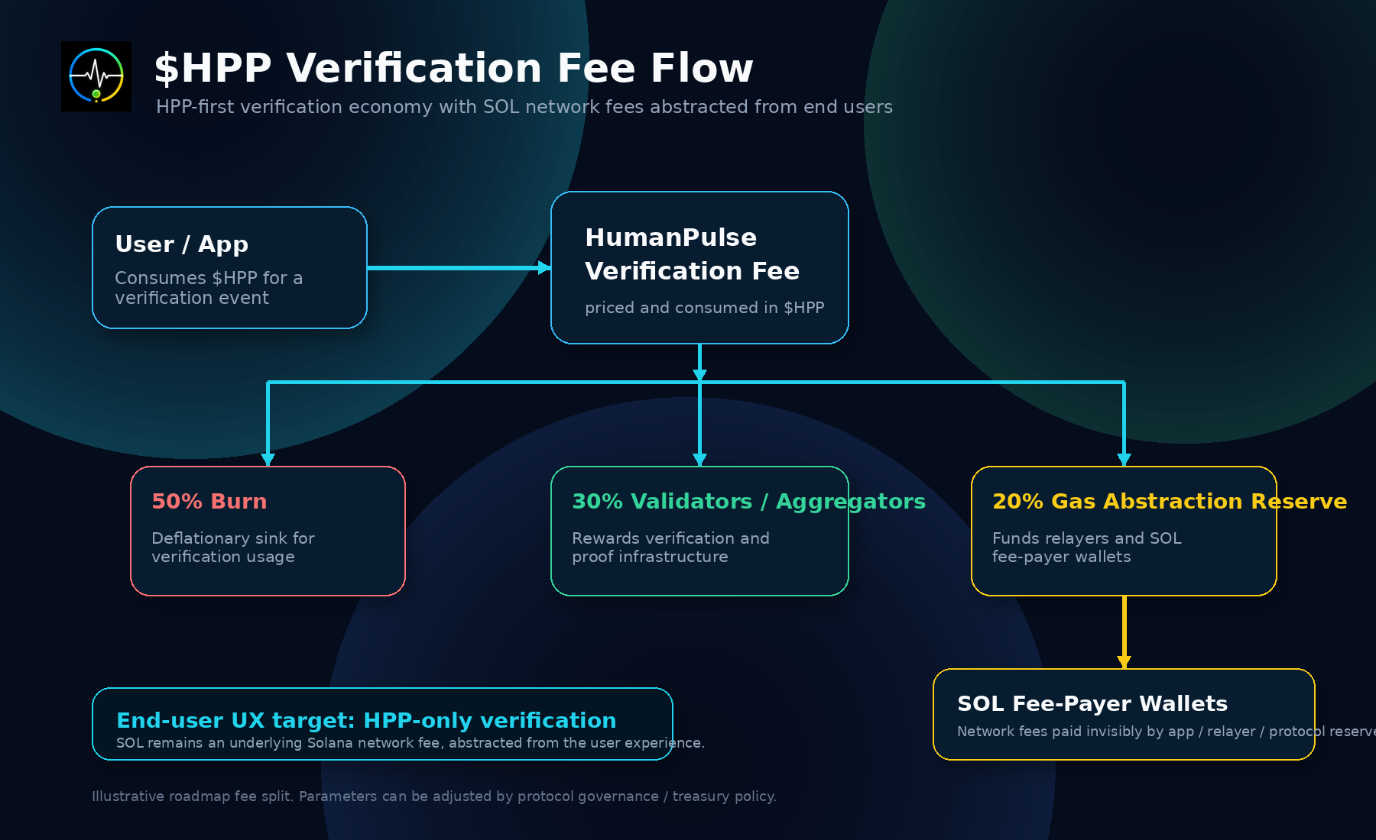

Slide 11
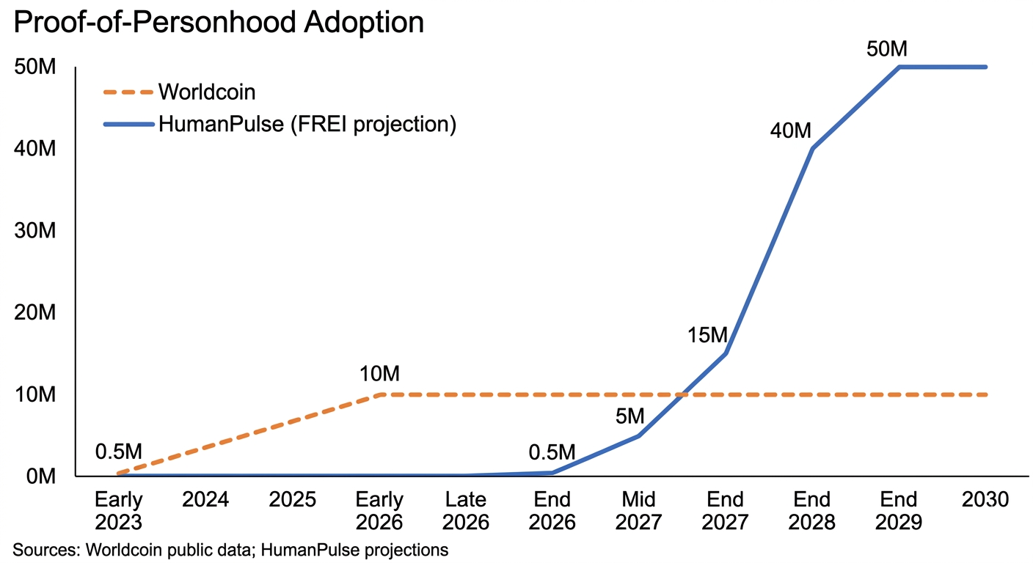
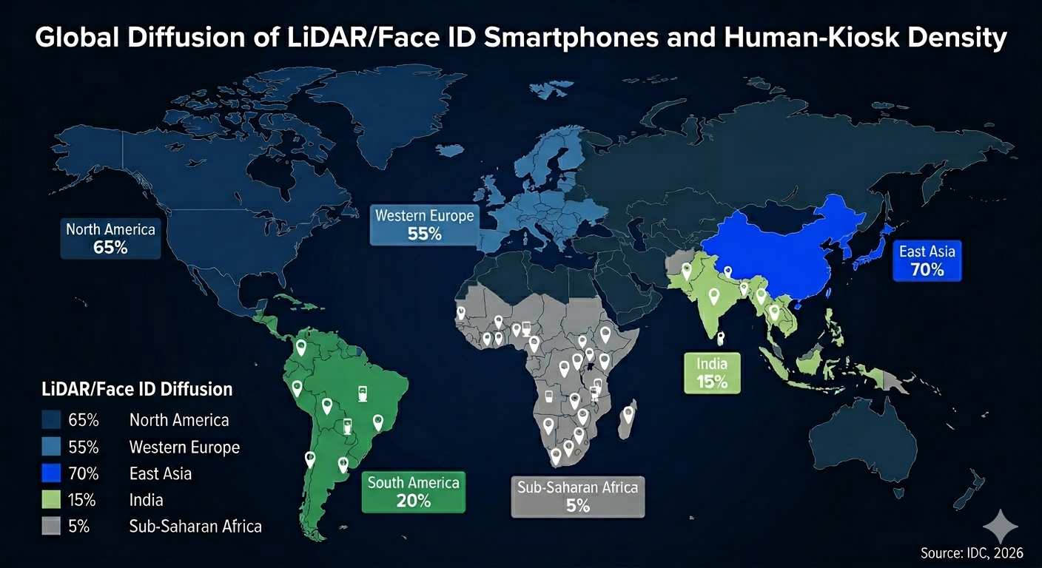
EXPANSION
From wedge to infrastructure
HumanPulse starts with anti-Sybil applications, but the long-term opportunity is a neutral uniqueness layer that can compound across digital ecosystems.
Near-term
Sybil-resistant DAO, airdrop, and token launch flows.
Mid-term
Wallets, exchanges, social applications, and consumer gating.
Long-term
A protocol-grade uniqueness layer for the AI era.
Source: HumanPulse Technical Whitepaper v7.2 and current MVP implementation.

Slide 12
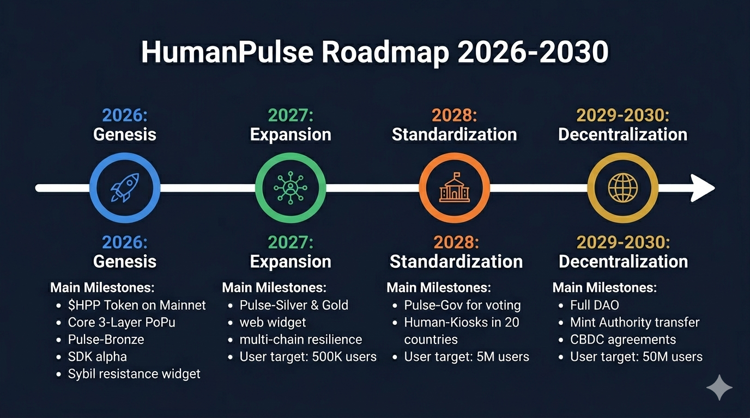
ROADMAP
From hackathon MVP to protocol-grade infrastructure
The roadmap separates near-term protocol hardening from optional research modules that may increase robustness over time.
Near-term buildout
Validator / aggregator layer, stronger proof pipeline, deeper integrations, and production-oriented hardening.
Research modules
Recursive zk-STARK aggregation, TEE-based local proof generation, LiDAR photonics, pupillary reflex, micro-expression analysis, and multi-device verification.
Message to judges
The hackathon MVP demonstrates the direction clearly today. The roadmap shows how the protocol can evolve without overstating current implementation status.
Source: HumanPulse Technical Whitepaper v7.2 and current MVP implementation.

Slide 13
CLOSING
Prove humanity. Preserve privacy. Build on Solana.
HumanPulse is designed to provide a privacy-first proof of unique human presence for the AI era.
GitHub Repository
github.com/humanpulseprotocol/HumanPulse-Protocol
Live Website
humanpulse-landing.vercel.app
Demo Video
humanpulse-landing.vercel.app/HumanPulse-demo.mp4
Technical Whitepaper
github.com/humanpulseprotocol/HumanPulse-Protocol/blob/main/HumanPulse%20Protocol/whitepaper/HumanPulse_Technical_Whitepaper_v7.2_FINAL.pdf
Solana Devnet Program
explorer.solana.com/address/D9tRQi8nZzARTJZXTmSsy4hrx4BwKUNPezKzayvQ5B5N?cluster=devnet
$HPP Token on Devnet
explorer.solana.com/address/EsBZKfFmhVAypmVm6QmenevZ56XZQZUjYF8CLzVnZSnR?cluster=devnet
Example Devnet proof-consumption transaction:
explorer.solana.com/tx/24rntJEHewfqhya5qum4zy9JRCmghYvbgUvNXHAXqZSdujgz5vNzY7KzPaT91YvY1u9AriGGvEP8ugxJaC3PyjLu?cluster=devnet
Official links shown here reflect the current MVP packaging for Solana Frontier Hackathon.

